Slide 1
Personal finance tracker
Using Excel & Tableau for Data-Driven Financial Insights
*Presented by:* [Astha Gaur]

Slide 2
Introduction
Managing personal finances is crucial for achieving financial independence and future goals.
- Tracking income and expenses helps identify spending patterns and supports informed decision-making.
- This project uses Excel for data entry and Tableau for interactive visualization.

Slide 3
Project goal
Develop a comprehensive personal finance tracker
- Provide clear visual insights into monthly income, expenses, and savings.
- Enable easy identification of trends, high-spending categories, and opportunities to save more.

Slide 4
Data Collection & Preparation
Data of income and expenses was recorded and structured in Excel.-
Categories include: Dining Out, Education, Entertainment, Groceries, Healthcare, Insurance, Investments, Rent, Transportation, Utilities.-
Data was cleaned and imported into Tableau for interactive dashboards.

Slide 5
Dashboard Overview
The main dashboard combines line charts, bar charts, and pie charts for a holistic view. - Key metrics displayed: Monthly income, total expenses, savings, and savings rate.

Slide 6
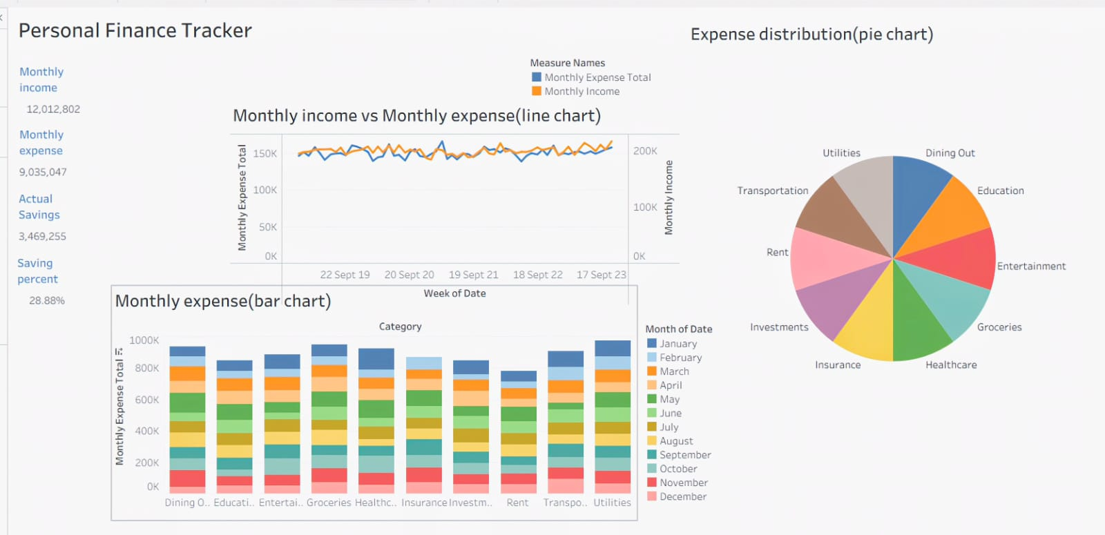
Add a Slide Title - 2
.

Slide 7
Monthly Income vs. Expenses
The line chart visualizes monthly income versus total expenses over time.
Reveals surplus or deficit trends and monitors financial health.

Slide 8
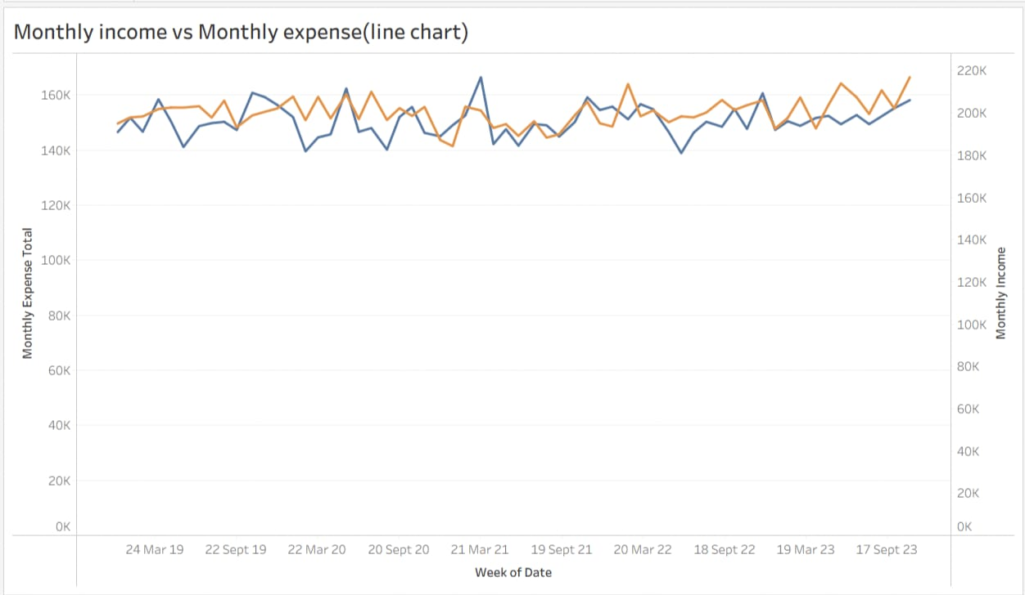

Slide 9
Expense distribution pie chart
- The *pie chart* illustrates how spending is distributed across categories.
- Highlights major spending areas, making it easy to find where to cut costs.

Slide 10
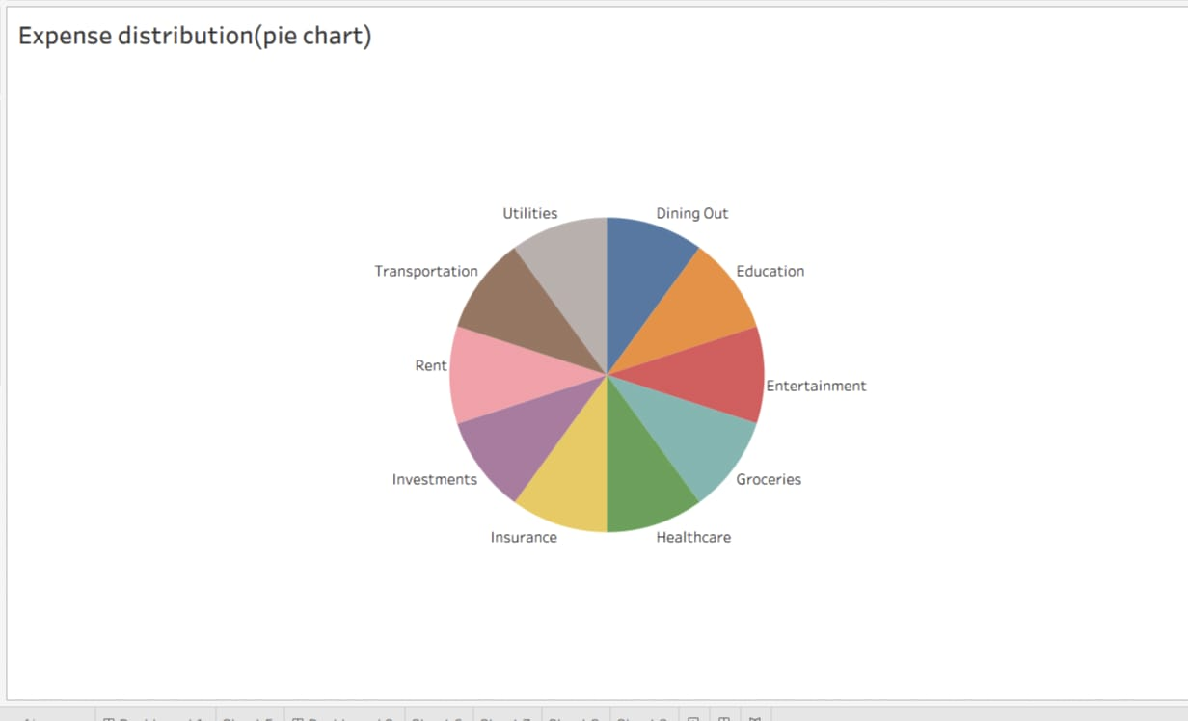

Slide 11
Monthly expenses bar chart
The *bar chart* shows expenses by category and by month for granular analysis.
Identifies patterns, recurring expenses, and seasonal variations.

Slide 12
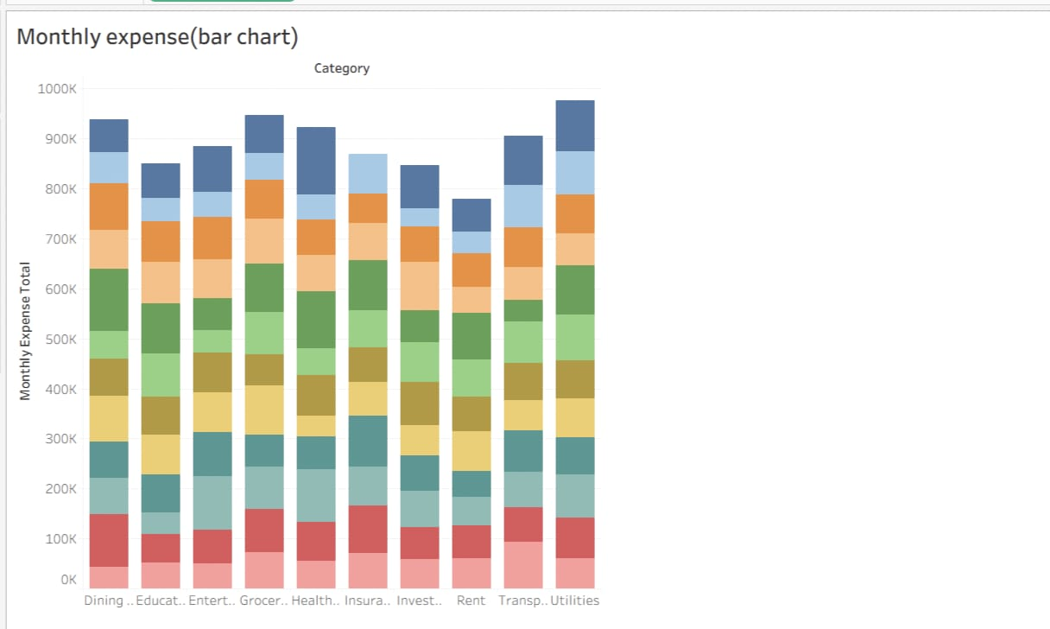

Slide 13
key Findings & Analysis
- Income generally exceeds expenses, indicating positive cash flow.
- Highest expenses are in categories such as [insert major categories identified from your charts].
- Opportunities exist to optimize spending in [specific categories].- Consistent savings growth over tracked months.

Slide 14
Conclusion
- The finance tracker successfully visualizes income, expenses, and savings trends.
- Insights support smarter budgeting and better financial decisions.
- Future work: Automate data import and add predictive analytics to forecast expenses and savings.

Slide 15
Thank you!

